Slide 1
Java Lecture 4

Slide 2
Java Basics
Escape sequence
    \b backspace
    \t tab
    \n linefeed
    \r carriage return
    \” double quote
    \’ single quote
    \\ backslash

Slide 3
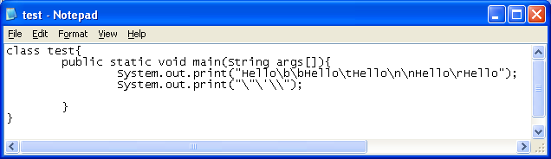
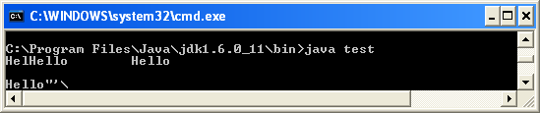
Java Basics
  Escape sequence example

Slide 4
Java Basics
Operators in java
    Arithmetic operator
      (+,-,*,/,%,++,--,+=,-=,*=/=,%=)
    Relational operator
      (==,!=,>,<,>=,<=)
    Logical operator
        (&&,||)
    Assignment operator
        ( = )
    The ? Operator
        Expression1 ? Expression2 : Expression3;

Slide 5
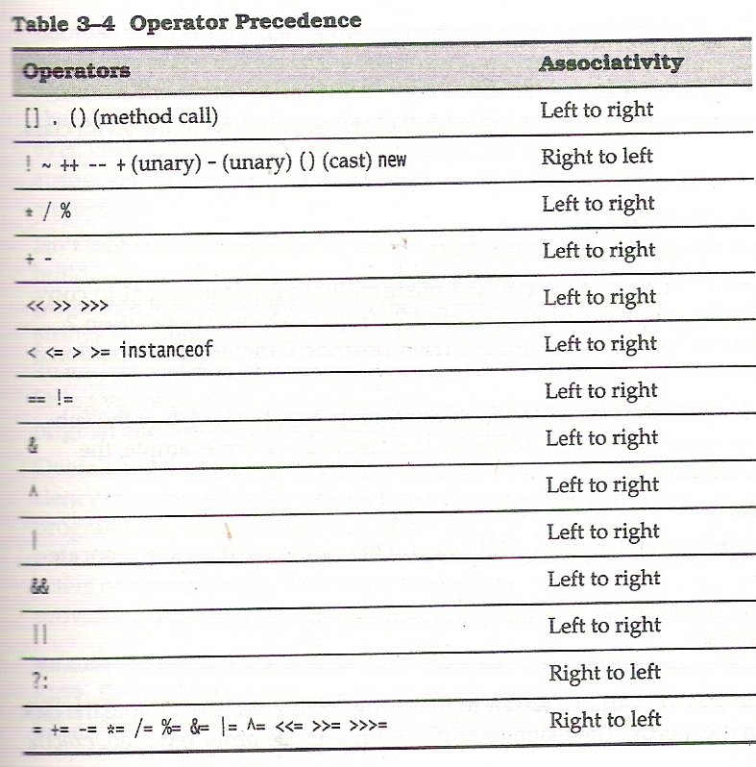
Java Basics
Precedence of
operators

Slide 6
Java Basics
Math class
    Double Math.sqrt(double) // double a=Math.sqrt(5.2);
    Double Math.exp(double)
    Double Math.log(double)
    Double Math.pow(double y, double x) //Math.pow(2.0,3.0); //8
    Double Math.sin(double)
    Double Math.cos(double)
    Double Math.tan(double)
    Double Math.asin(double)
    Double Math.acos(double)
    Double Math.atan(double)
    Double Math.random() //return value between 0 and not quite 1
    Math.PI
    Math.e

Slide 7
Looping in java
do while Loop
  Syntax:
      intialization;
      do {
      statements to run while condition is true
      } while(condition)
  Example :
      int i=0;
      do{
      System.out.println(“Hello”);
      i++;
      } While(i<10)

Slide 8
Switch-case
For multiple selection
    Syntax: switch(variable)
        {
        case value1:
        ……break;
        case value2:
        …..break;
        case value3:
        …..break;
        default:
        …..break;
        }

Slide 9
Switch-case
For multiple selection
    Example: int choice=Integer.parseInt(d.readLine());
        switch(choice)
        {
        case 1: ….
        break;
        case 2: ….
        break;
        default: //bad choice
        break;
        }

